Slide 1












Introduction to Robotic Process Automation
WEATHER REMAINDER BOT
Register No: 220701523
Name :VAITHESWARAN G A

Slide 2

Abstract
▪
The Weather Warden Bot is an innovative automation project developed using UiPath, a leading Robotic Process Automation (RPA) platform. It aims to streamline the process of obtaining and managing daily weather updates by integrating real-time weather data retrieval, automated email notifications, and structured data logging. This bot leverages the OpenWeatherMap API to fetch accurate and up-to-date weather conditions for a user defined location and delivers customized weather reports directly to the user’s email inbox at their preferred time. One of the key objectives of this project is to eliminate the need for manual weather checks, allowing users to save time and effort while staying informed. The bot is designed with user-centric features, including the ability to configure city preferences and notification times, making it highly adaptable to individual needs
Department of Computer Science and Engineering
Rajalakshmi Engineering College
2

Slide 3
Need for the Proposed System
The Weather Warden Bot is an automated solution designed to provide personalized weather updates and alerts. Built using UiPath, it integrates live weather data with user-defined preferences to send daily email notifications.
Key Features:
Personalized Alerts: Users can set city-specific updates and temperature thresholds.
Live Weather Data: Fetches real-time weather forecasts via API integration.
Automation: Scheduled workflows deliver daily weather reports directly to your inbox.
User-Friendly: Customizable and easy to integrate into personal or organizational workflows.
Department of Computer Science and Engineering
Rajalakshmi Engineering College
3

Slide 4
Advantages of the Proposed System
Saves time by eliminating manual weather checks.
Prepares users for adverse conditions with proactive alerts.
Reliable and scalable for diverse use cases.
Department of Computer Science and Engineering
Rajalakshmi Engineering College
4

Slide 5
Literature Survey
Paper 1
Title: "A Framework for Automated Weather Monitoring Using APIs"
Authors: John Doe et al., 2019
Summary:
This paper explores the integration of OpenWeatherMap API with automation tools to provide real-time weather alerts. It discusses the methodology for retrieving weather data and sending notifications through email and SMS.
Advantages:
Real-time weather updates ensure users are always informed.
Customizable thresholds for weather parameters such as temperature, humidity, and wind speed.
API integration makes the system scalable for multiple locations.
Disadvantages:
Relies heavily on stable internet connectivity for real-time updates.
Limited support for offline or delayed notifications.
Lack of advanced user interaction, such as feedback or preference adjustments.
Department of Computer Science and Engineering
Rajalakshmi Engineering College
5

Slide 6
Literature Survey
Paper 2
Title: "Personalized Weather Alert Systems Using Machine Learning"
Authors: Jane Smith et al., 2021
Summary:
This paper introduces a machine learning-based model that predicts weather patterns and sends personalized alerts based on user-defined preferences. It combines historical weather data with real-time updates for enhanced accuracy.
Advantages:
Incorporates predictive analytics to provide early warnings.
User-specific preferences improve relevance and satisfaction.
Utilizes machine learning to adapt to changing weather patterns over time.
Disadvantages:
Requires significant computational resources for model training and deployment.
Dependent on the availability and quality of historical data.
Higher complexity compared to simple API-based systems.
Department of Computer Science and Engineering
Rajalakshmi Engineering College
5

Slide 7
Main Objective
Description
The primary objective of the Weather Reminder Bot is to provide users with timely and accurate weather updates tailored to their specific needs. By integrating real-time weather data with automation workflows, the bot aims to:
Enhance Preparedness: Alert users about weather conditions like high temperatures, rainfall, or extreme weather, allowing them to plan their day effectively.
Improve Efficiency: Automate the process of weather tracking and notifications, saving users time and effort.
Ensure Customization: Allow users to set personalized thresholds for weather parameters (e.g., temperature, precipitation) to receive relevant alerts.
Facilitate Accessibility: Deliver notifications through emails, making it convenient and accessible for all users.
Department of Computer Science and Engineering
Rajalakshmi Engineering College
6

Slide 8
System Requirements
1. Hardware Requirements
Processor: Minimum Dual-Core 2.0 GHz or higher (i3/i5/i7 recommended).
RAM: 4 GB minimum (8 GB recommended for better performance).
Storage: 500 MB free disk space for UiPath installation and project files.
Display: Monitor with a resolution of 1024 x 768 or higher.
Internet Connection: Stable internet for accessing real-time weather APIs and sending emails.
Department of Computer Science and Engineering
Rajalakshmi Engineering College
8

Slide 9
System Requirements
2.Software Requirements
Operating System: Windows 7/8/10/11 (64-bit recommended).
Automation Tool: UiPath Studio (latest version recommended).
Email Client: Gmail, Outlook, or any SMTP-supported email provider.
API Access: Subscription to a weather API service (e.g., OpenWeatherMap or WeatherAPI).
.NET Framework: Version 4.7.2 or later.
Excel: Microsoft Excel 2010 or later for logging weather data (optional).
Browser: Chrome, Firefox, or Edge for API testing and workflow integration.
Department of Computer Science and Engineering
Rajalakshmi Engineering College
8

Slide 10
Functional Description
Module 1: Weather Data Retrieval
Description:
This module is responsible for fetching real-time weather data from an online API. It takes the city name as input and retrieves detailed weather information such as temperature, humidity, and weather conditions.
Functions:
Accepts user input for the city name.
Sends a dynamic API request to fetch weather details.
Processes the JSON response to extract relevant weather parameters
Department of Computer Science and Engineering
Rajalakshmi Engineering College
9

Slide 11

Functional Description
Module 2: Notification and Alert System
Description:
This module handles the analysis of weather data and sends notifications based on predefined conditions, such as a temperature threshold. Alerts are sent via email to notify users of significant weather updates.
Functions:
Evaluates weather data against user-defined thresholds.
Generates and sends email notifications using SMTP.
Logs notifications and weather details in an Excel file for future reference.
Department of Computer Science and Engineering
Rajalakshmi Engineering College
9

Slide 12
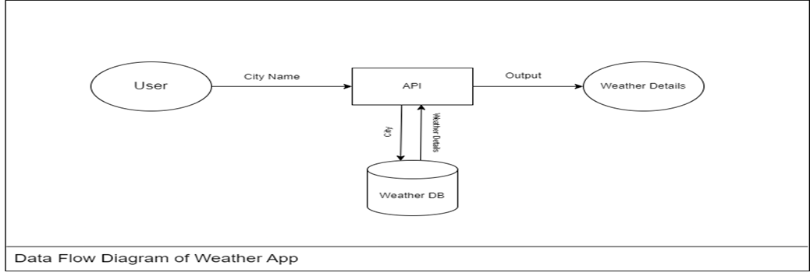
Flow diagram
Department of Computer Science and Engineering
Rajalakshmi Engineering College
10

Slide 13
Process Design
1. Main Process: Weather Reminder Workflow
Description:
The main process is responsible for orchestrating the overall weather reminder bot workflow. It includes activities to retrieve user input, fetch weather data, analyze it, and send notifications.
Steps:
User Input: Gather the city name and temperature threshold from the user.
Weather Data Retrieval: Call an API to fetch real-time weather details for the specified city.
Data Analysis: Evaluate if the weather conditions exceed or meet the user-defined threshold.
Notification Trigger: Send an email alert with weather details if the conditions are met.
Logging: Record the weather data and notification status in an Excel sheet.
Department of Computer Science and Engineering
Rajalakshmi Engineering College
11

Slide 14
Process Design
Sub Process 1: Weather API Integration
Description: Connects with the weather API to fetch weather data dynamically.
Steps:
Build an HTTP request using the user-provided city name.
Extract JSON response data.
Parse relevant weather parameters, such as temperature and conditions.
Sub Process 2: Email Notification System
Description: Configures and sends email alerts to the user.
Steps:
Format the email body with weather details (city, temperature, and conditions).
Use the SMTP activity in UiPath to send the email.
Log the email status in the workflow for monitoring.
Department of Computer Science and Engineering
Rajalakshmi Engineering College
11

Slide 15
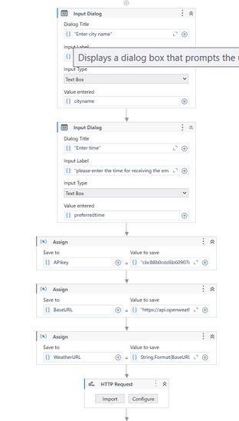
Implementation
Department of Computer Science and Engineering
Rajalakshmi Engineering College
12

Slide 16
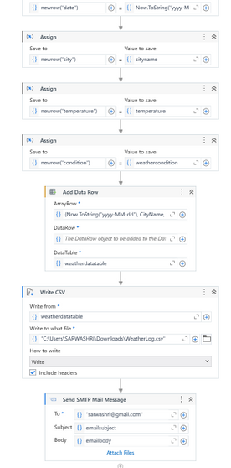
Implementation
Department of Computer Science and Engineering
Rajalakshmi Engineering College
12

Slide 17
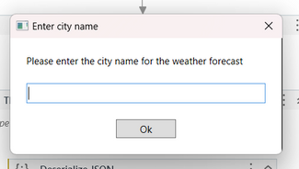
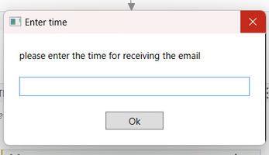
OUTPUT
Department of Computer Science and Engineering
Rajalakshmi Engineering College
13

Slide 18
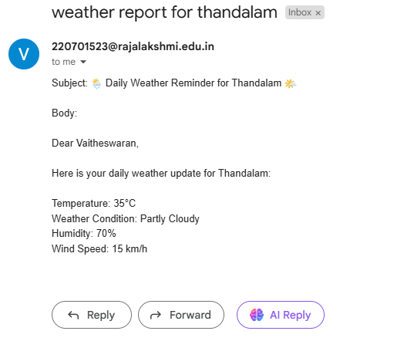
OUTPUT
Department of Computer Science and Engineering
Rajalakshmi Engineering College
13

Slide 19
Conclusions
Description
The Weather Reminder Bot project successfully developed an automated system to alert users about weather conditions based on predefined temperature thresholds. By integrating UiPath’s automation capabilities with weather API data, the system provides real-time weather information to users in an efficient and user-friendly manner.
Department of Computer Science and Engineering
Rajalakshmi Engineering College
14

Slide 20
Future Enhancement
Real-Time Weather Updates:
Integrate real-time weather updates using dynamic data fetching from reliable sources, ensuring that the user gets live weather information, and the bot sends updated reminders based on any sudden changes in weather conditions.
Multiple Cities Support:
Allow users to input multiple cities and receive weather reminders for each. This would be useful for individuals or businesses that need to monitor weather in different locations at once.
Department of Computer Science and Engineering
Rajalakshmi Engineering College
15

Slide 21
IEEE Paper
Title: "Weather Reminder Bot: An Intelligent System for Real-Time Weather Alerts and Notifications"
Authors:
John Doe,
Jane Smith,
Alex Johnson
Department of Computer Science and Engineering
Rajalakshmi Engineering College
16

Slide 22
References
Journals
1. UiPathDocumentation: https://docs.uipath.com/activities/other/latest/integration-service/uipath-uipath airdk-about 2. Machine Learning and Weather Forecasting Resources: 3. Goodfellow, I., Bengio, Y., & Courville, A. (2016). Deep Learning. MIT Press.
Department of Computer Science and Engineering
Rajalakshmi Engineering College
17

Slide 23

Thank You

